Slide 1
Chapter 7: Synchronization Examples

Slide 2
Outline
Explain the bounded-buffer synchronization problem
Explain the readers-writers synchronization problem
Explain and dining-philosophers synchronization problems
Describe the tools used by Linux and Windows to solve synchronization problems.
Illustrate how POSIX and Java can be used to solve process synchronization problems

Slide 3
Classical Problems of Synchronization
Classical problems used to test newly-proposed synchronization schemes
Bounded-Buffer Problem
Readers and Writers Problem
Dining-Philosophers Problem

Slide 4
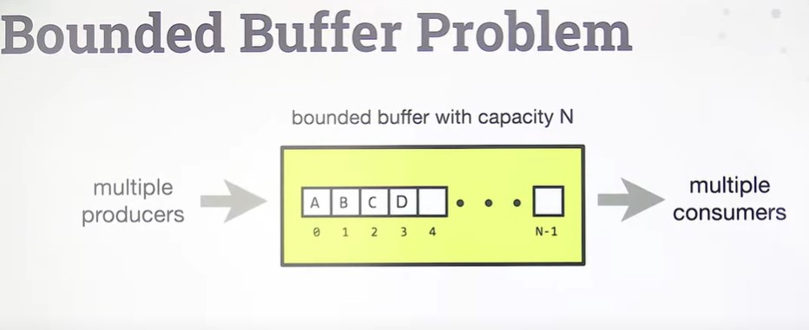

Slide 5
Bounded-Buffer Problem
n buffers, each can hold one item
Semaphore mutex initialized to the value 1
Semaphore full initialized to the value 0
Semaphore empty initialized to the value n

Slide 6
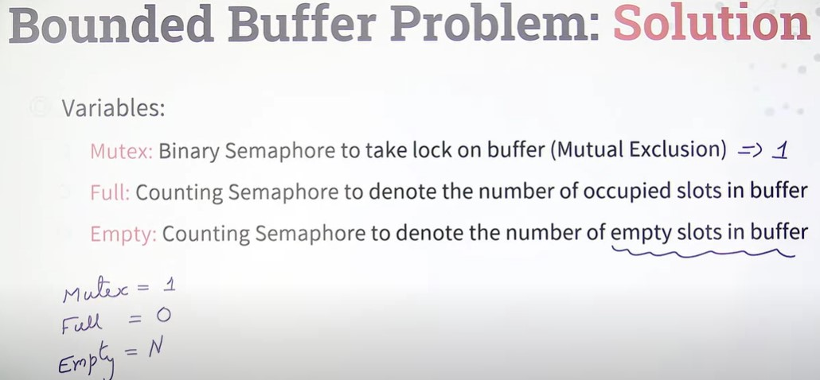

Slide 7
Bounded Buffer Problem (Cont.)
The structure of the producer process
while (true) {
... /* produce an item in next_produced */
...
wait(empty);
wait(mutex);
... /* add next produced to the buffer */
...
signal(mutex);
signal(full);
}

Slide 8
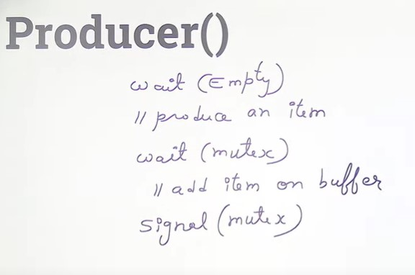
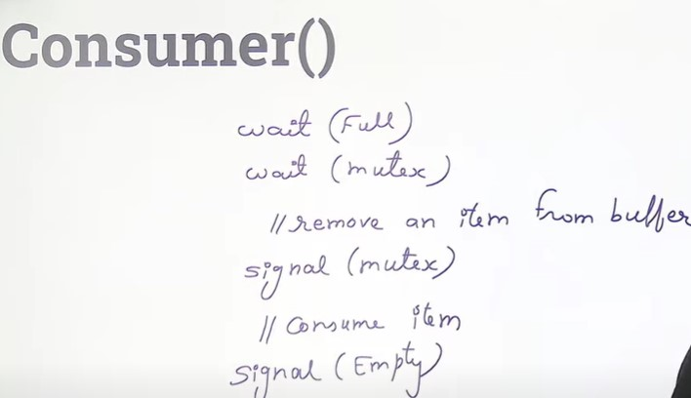

Slide 9
Bounded Buffer Problem (Cont.)
The structure of the consumer process
while (true) {
wait(full);
wait(mutex);
... /* remove an item from buffer to next_consumed */
...
signal(mutex);
signal(empty);
... /* consume the item in next consumed */
... }

Slide 10
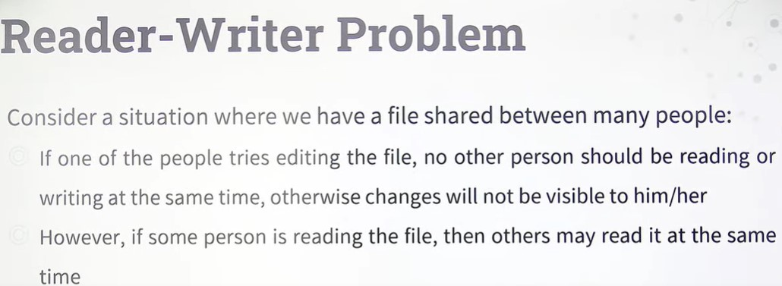
Reader Writer Problem

Slide 11
Readers-Writers Problem
A data set is shared among a number of concurrent processes
Readers – only read the data set; they do not perform any updates
Writers – can both read and write
Problem – allow multiple readers to read at the same time
Only one single writer can access the shared data at the same time
Several variations of how readers and writers are considered – all involve some form of priorities

Slide 12
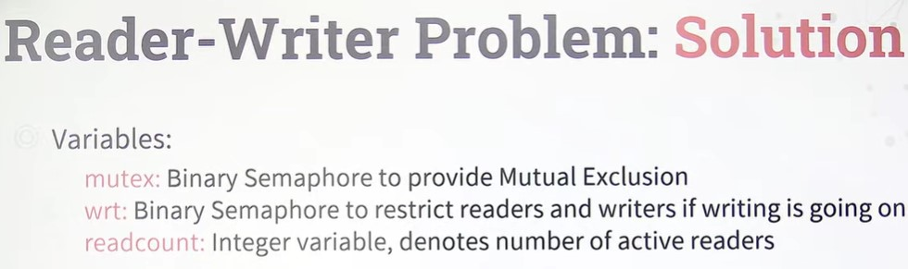
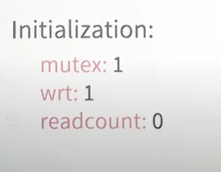
Reader Writer Problem

Slide 13
Readers-Writers Problem (Cont.)
Shared Data
Data set
Semaphore rw_mutex initialized to 1
Semaphore mutex initialized to 1
Integer read_count initialized to 0

Slide 14
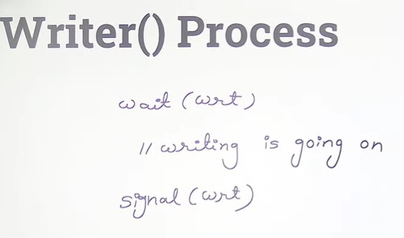
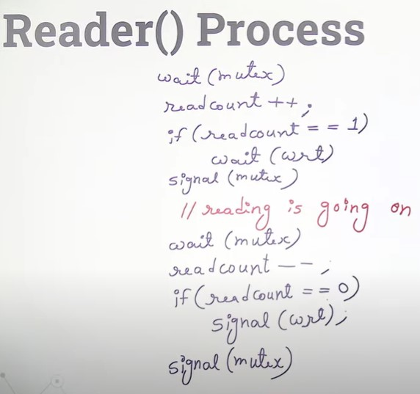
Reader Writer Problem

Slide 15
Readers-Writers Problem (Cont.)
The structure of a writer process
while (true) { wait(rw_mutex);
... /* writing is performed */
...
signal(rw_mutex);
}

Slide 16
Readers-Writers Problem (Cont.)
The structure of a reader process
while (true){ wait(mutex); read_count++; if (read_count == 1) /* first reader */
wait(rw_mutex);
signal(mutex);
... /* reading is performed */
...
wait(mutex); read_count--; if (read_count == 0) /* last reader */
signal(rw_mutex);
signal(mutex);
}

Slide 17
Readers-Writers Problem Variations
The solution in previous slide can result in a situation where a writer process never writes. It is referred to as the “First reader-writer” problem.
The “Second reader-writer” problem is a variation the first reader-writer problem that state:
Once a writer is ready to write, no “newly arrived reader” is allowed to read.
Both the first and second may result in starvation. leading to even more variations
Problem is solved on some systems by kernel providing reader-writer locks

Slide 18
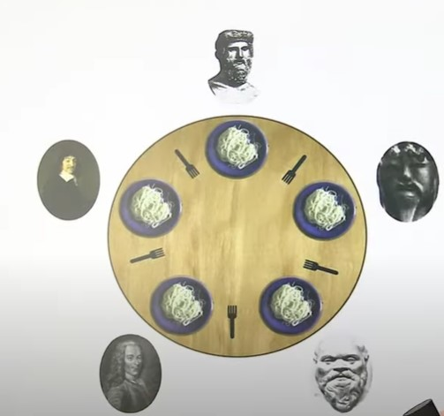

Slide 19

Dining-Philosophers Problem
N philosophers’ sit at a round table with a bowel of rice in the middle.
They spend their lives alternating thinking and eating.
They do not interact with their neighbors.
Occasionally try to pick up 2 chopsticks (one at a time) to eat from bowl
Need both to eat, then release both when done
In the case of 5 philosophers, the shared data
Bowl of rice (data set)
Semaphore chopstick [5] initialized to 1

Slide 20
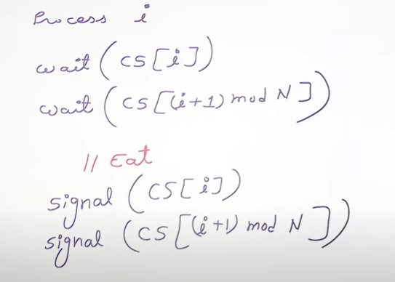

Slide 21
Dining-Philosophers Problem Algorithm
Semaphore Solution
The structure of Philosopher i :
while (true){
wait (chopstick[i] );
wait (chopStick[ (i + 1) % 5] );
/* eat for awhile */
signal (chopstick[i] );
signal (chopstick[ (i + 1) % 5] );
/* think for awhile */
}
What is the problem with this algorithm?

Slide 22
Monitor Solution to Dining Philosophers
monitor DiningPhilosophers
{
enum {THINKING; HUNGRY, EATING} state [5];
condition self [5];
void pickup (int i) {
state[i] = HUNGRY;
test(i);
if (state[i] != EATING) self[i].wait;
}
void putdown (int i) {
state[i] = THINKING;
// test left and right neighbors
test((i + 4) % 5);
test((i + 1) % 5);
}

Slide 23
Solution to Dining Philosophers (Cont.)
void test (int i) {
if ((state[(i + 4) % 5] != EATING) &&
(state[i] == HUNGRY) &&
(state[(i + 1) % 5] != EATING) ) {
state[i] = EATING ;
self[i].signal () ;
}
}
initialization_code() {
for (int i = 0; i < 5; i++)
state[i] = THINKING;
}
}

Slide 24
Solution to Dining Philosophers (Cont.)
Each philosopher “i” invokes the operations pickup() and putdown() in the following sequence:
DiningPhilosophers.pickup(i);
/** EAT **/
DiningPhilosophers.putdown(i);
No deadlock, but starvation is possible

Slide 25
End of Chapter 7

